Slide 1


SIMATS ENGINEERING
SAVEETHA INSTITUTE OF MEDICAL AND TECHNICAL SCIENCES
Technical presentation
CSA0378-Data Structures with Computational Methods
Metro Rail Network Reachability Analysis Using Graph Data Structure
PRESENTED BY:
K. Manoj Kumar(192472395)

Slide 2
Introduction
Metro rail systems are widely used for fast, safe, and efficient urban transportation.
A metro network consists of multiple stations connected through railway routes.
Managing and analyzing connections between stations is important for route planning and passenger navigation.
To determine whether a station is reachable from a source station, an efficient data structure is required.
In a metro rail network, stations can be represented as nodes and routes as connections between them.

Slide 3
Objectives
To represent a metro rail network using an appropriate data structure.
To model metro stations as vertices (nodes) and routes as edges.
To determine the reachable stations from a given source station.
To enable efficient traversal of the metro network using graph algorithms.
To support route planning and connectivity analysis.
To identify the shortest or most efficient path between stations.
To improve the management and visualization of metro rail connections.

Slide 4
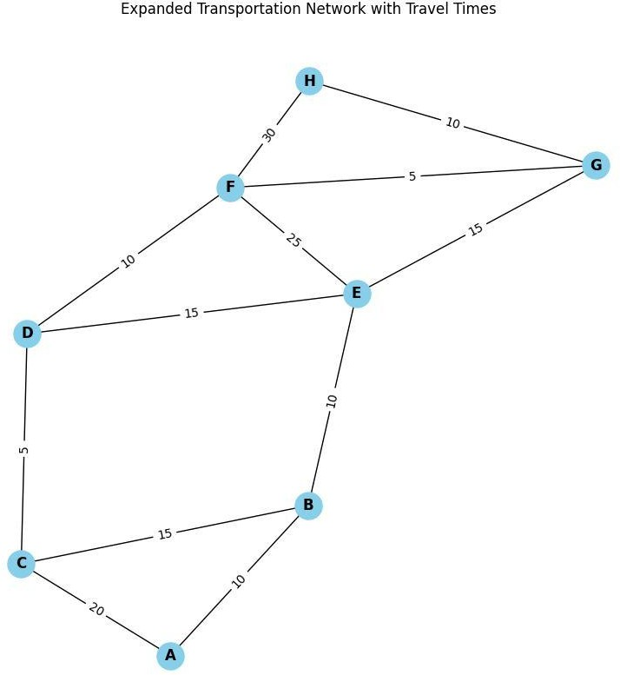
Problem Statement
A metro rail network consists of multiple stations connected throug
various routes.
The system must identify all stations that are reachable from a give source station.
Efficient route planning and connectivity analysis are required for
passenger navigation.
As the number of stations and routes increases, managing the network becomes more complex.
A suitable data structure is needed to represent station connections effectively.
The solution should support fast traversal and route discovery.
h
n

Slide 5


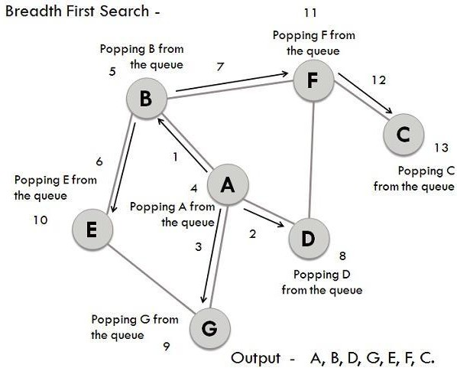
Methodology
Represent each metro station as a vertex (node) in a graph.
Represent each route connecting two stations as an edge.
Create a graph structure to store all station and route information.
Select a source station from which reachability is to be
determined.
Apply graph traversal algorithms such as Breadth-First Search (BFS) or Depth-First Search (DFS).Visit all connected stations starting from the source station.
Mark and record the reachable stations during traversal.

Slide 6
Results & Discussion
The metro rail network was successfully represented using a Graph data structure.
Stations were modeled as vertices, and routes were represented as edges between stations.
The graph efficiently stored and managed all station connections.
Using BFS/DFS traversal, all reachable stations from a given source station were identified successfully.
The system provided a clear representation of connectivity within the metro network.
Route discovery and navigation became easier through graph traversal techniques.
The graph structure supported efficient analysis of station reachability and network
connectivity.

Slide 7
Applications
Metro Rail and Railway Route Management Systems.
Navigation and Route Planning Applications.
Public Transportation Networks.
GPS and Mapping Systems.
Airline Route Management Systems.
Road and Traffic Network Analysis.
Logistics and Supply Chain Transportation.
Smart City Transportation Solutions.

Slide 8
Future Scope
Implement shortest path algorithms to find the fastest route between stations.
Integrate real-time train schedules and arrival information.
Develop a mobile application for passenger navigation and route planning.
Add fare calculation based on travel distance and stations covered.
Support multi-city metro network management.
Incorporate AI-based route recommendations for passengers.
Enable real-time traffic and congestion monitoring.
Integrate GPS and location-based services for live tracking.

Slide 9
Conclusion
The metro rail network was successfully represented using a Graph data structure.
Graphs effectively model stations as vertices and routes as edges.
The system efficiently determined reachable stations from a given source station.
Graph traversal algorithms such as BFS and DFS helped analyze network connectivity.
The implementation simplified route planning and station reachability analysis.
The graph structure proved to be scalable and suitable for large metro networks.
Overall, graphs provide an efficient and reliable solution for metro rail network management
and navigation systems.

